Slide 1
Restaurant Finder
By Anirudh Kulkarni

Slide 2
Description
A command line application which takes in the current location of the user (City name) and gets the exact coordinates for the city name defined. Then uses the Zomato API to find out a restaurant in that city ( picked dynamically not hard coded), and then finds the cab fare prices between your current location and the restaurant location, and display it on the screen.
The programming language used was Python 3.8

Slide 3
What is an API?
An application program interface (API) is a set of routines, protocols, and tools for building software applications.
An API specifies how software components should interact.
In this particular project the Zomato API was used.

Slide 4
Zomato API
Zomato API is an API given for the developers to develop projects by the famous food delivering company Zomato.
It offers a free plan of 1000 calls per day.
This API uses various parameters such city name, the coordinates the cuisines you are interested in and returns the name of the restaurants, the cuisines it offers and much more.
The access link for the same is: https://developers.zomato.com/api

Slide 5
GEOPY
geopy is a Python client for several popular geocoding web services.
geopy makes it easy for Python developers to locate the coordinates of addresses, cities, countries, and landmarks across the globe using third-party geocoders and other data sources.
geopy includes geocoder classes for the OpenStreetMap Nominatim , Google Geocoding API (V3), and many other geocoding services.

Slide 6
Fare Estimation
In recent times Uber and Ola have taken off their APIs which was first supposed to be free.
So as to get a fare estimate in this project, the conditions for Uber fare calculations were used.
Using the geopy, distance was calculated and satisfying the necessary condition as estimate travel price was given.

Slide 7
Project Algorithm
Take 2 inputs from the user.
1. Current city.
2. Destination city.
Call the Search Restaurant function which give out the list of Restaurants and then dynamically print one.
Calling the Location and Estimate function for returning the coordinates of current location and also calculating the fare with the help of the total distance between the two cities.

Slide 8
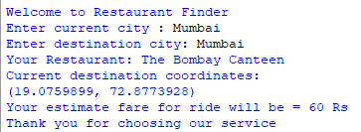
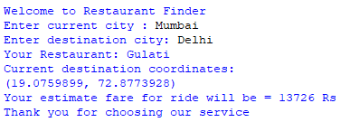
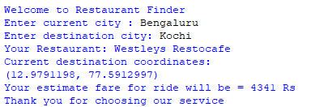
Results and Conclusion.
As we can observe in the images that we got the output as we were told to in the problem statement.

Slide 9
References
https://pypi.org/project/geopy/
https://www.webopedia.com/TERM/A/API.html#:~:text=An%20application%20program%20interface%20(API,user%20interface%20(GUI)%20components.

